Slide 1

UNION BANK OF CALIFORNIA
Commercial Real Estate Early Warning System:
National Indices
December 17, 2013
Dan Van Dyke
Lexi Russell
Brett Fawley

Slide 2
Methodology
The goal is to create an index that can be used to provide warning of changing commercial real estate (CRE) conditions.
During the last meeting (12/6/2013), we presented various measures of market conditions, and we related those measures to the cap rate spread. We thought that there is a lot of information contained in each measure, including the cap rate spread.
Given the information in each of the measures of CRE conditions, how can we combine them to provide a single measure (index) that in some sense “best” captures changing market conditions?
We suggested at that time that we would investigate using Principal Components Analysis (PCA) to do that.

Slide 3
Methodology, con’t.
PCA for create index
The results of the PCA examination of the CRE data for five product types proved to be very successful.
Without belaboring the technical discussion of PCA, we can say that it is a technique to describe the dynamics of a system for which we have various measures (or factors) by
  Reducing the set of variables needed to describe the data, and
  Filtering out the noise in the system.
In other words, PCA allows us, potentially, to develop a synthetic variable (index) that is a linear combination of the various measures of our system.
In PCA, the so-called “first principal component” is that linear combination of the measures that “best” fits the data, that is, that maximizes the explained variance.
The “second principal component” is one that is orthogonal (at right angles) to the first component, that “best” explains the residual variance not explained by the first component. And so on.

Slide 4
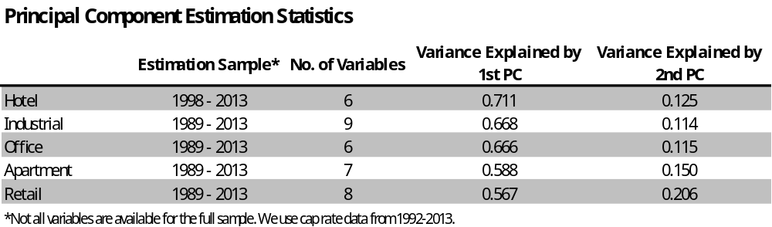
RCG Principal Component Statistics
Since we are trying to develop “one index,” we settle on the first principal component as our index.
In the table below, we see that the first principal component (PC) explains between 56.7% and 71.1% of the variance of the data set. To get this level of explained variance, we reduce the number of variables from between 6 and 9, depending on the product type, to just one—the first PC.
Just for the record, the first two PCs explain between 73.8% and 83.7% of the variance of the data set.
Finally, some of the variance in the data is “noise” and not “signal.”
4

Slide 5
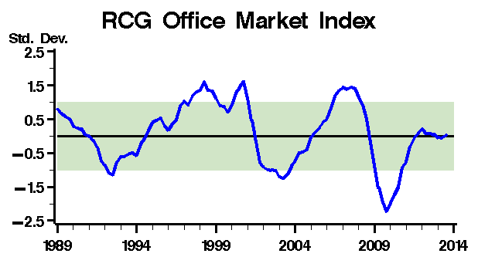
RCG Office Market Index
The Office Market Index is in broadly neutral territory, indicating no more than mean market risk.
Both the position and the direction of the index have significance.
5

Slide 6
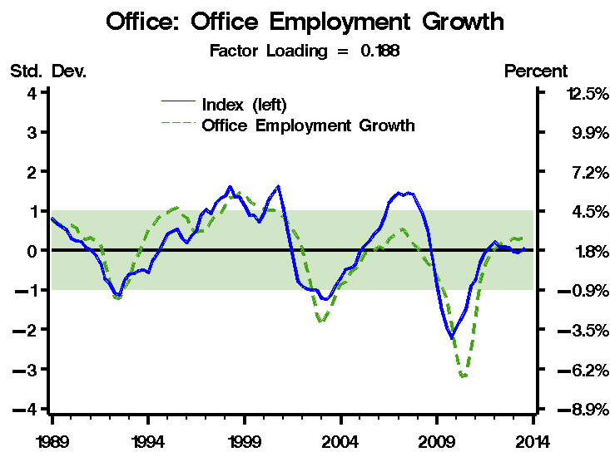
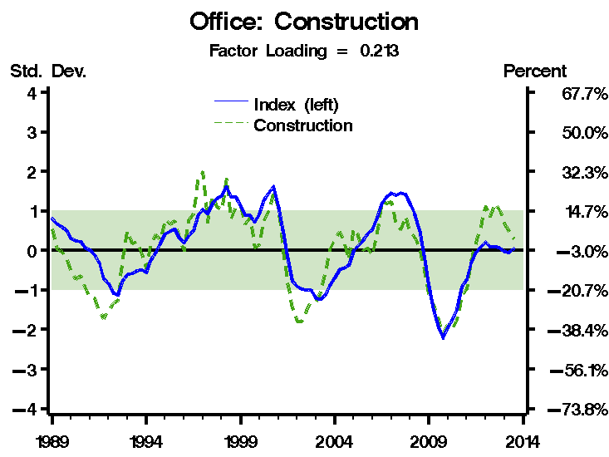
Office Market Index – Market Forces
Demand Indicator
Supply Indicator
Office employment, the key demand driver, is growing about 2.7%, or about 0.4 standard deviations from the mean growth of 1.8%.
There is no supply pressure, with construction gaining only slightly.
The “factor loading” for the demand and supply factor, respectively, are 0.188 and 0.213.
6

Slide 7
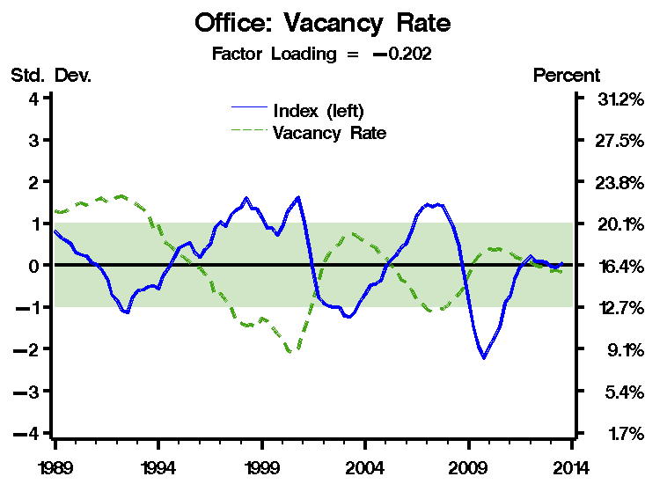
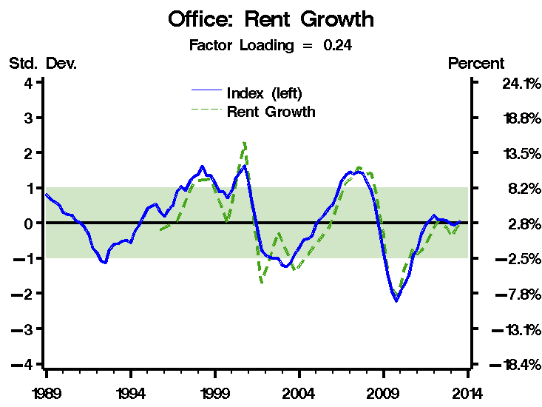
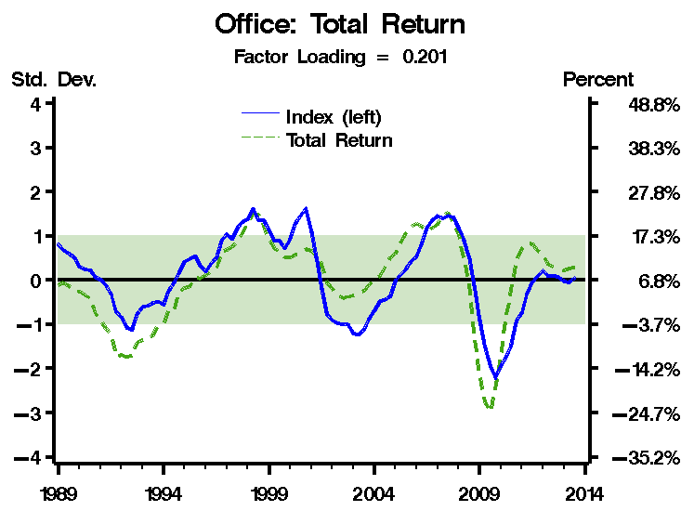
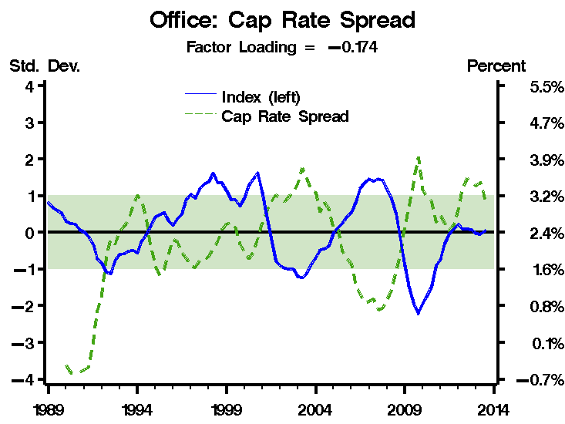
Office Market Index – Other Components
7

Slide 8

Real Estate Cycle Clock - Office
12
Overshooting Phase
Decline
Phase
9
3
Growth
Phase
Absorption
Phase
6
National Suburban Office - 4:30
National CBD Office - 6:00

Slide 9
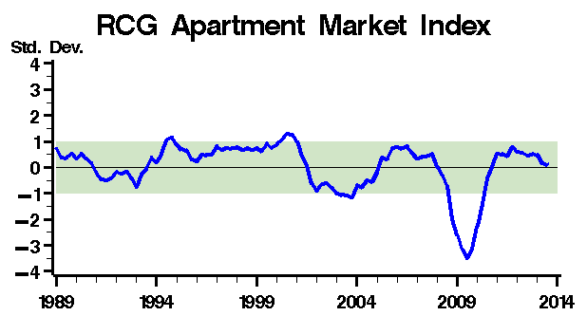
RCG Apartment Market Index
The Apartment Market Index is also in broadly neutral territory, indicating no more than mean market risk at the present time.
9

Slide 10
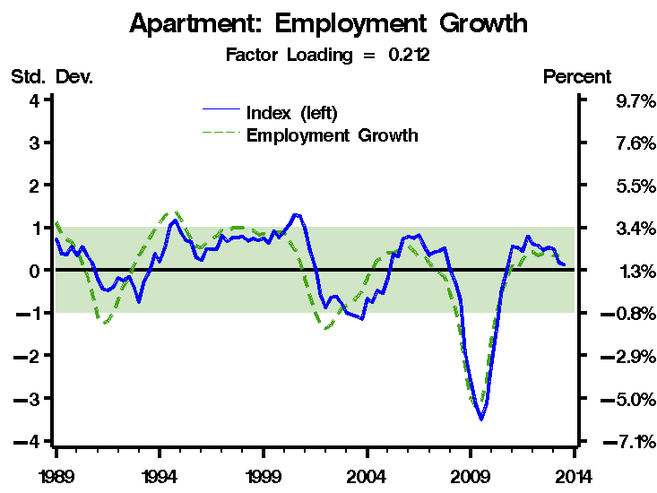
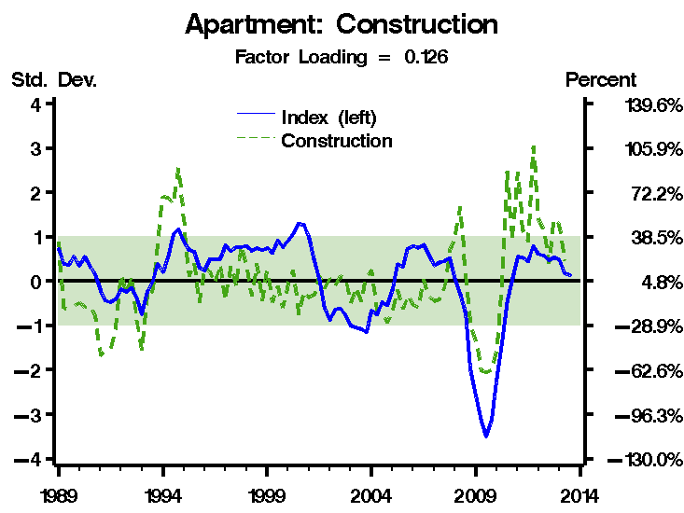
Apartment Market Index – Market Forces
Demand Indicator
Supply Indicator
A key demand driver is payroll employment growth. That measure at 2.0% is about 0.4 standard deviations from it mean growth of 1.4%.
Construction is gaining at about a 15% pace, or about 0.5 standard deviations from the mean gain of 4.8%.
10

Slide 11
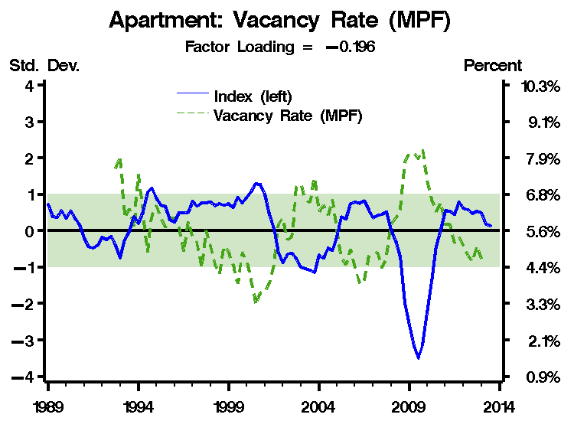
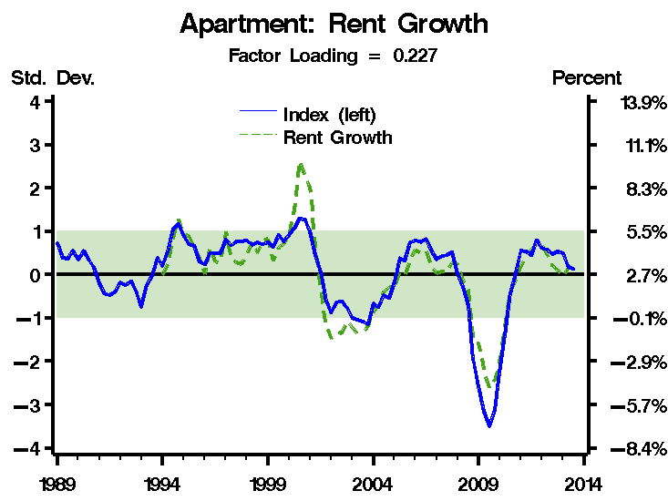
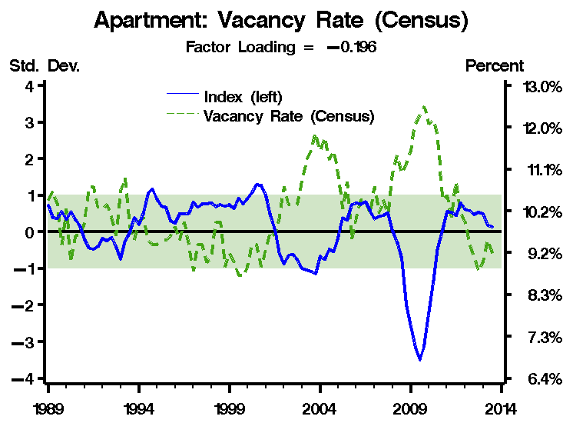
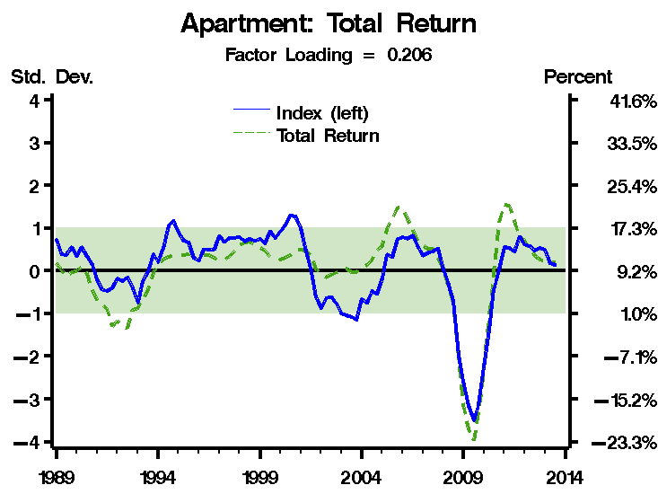
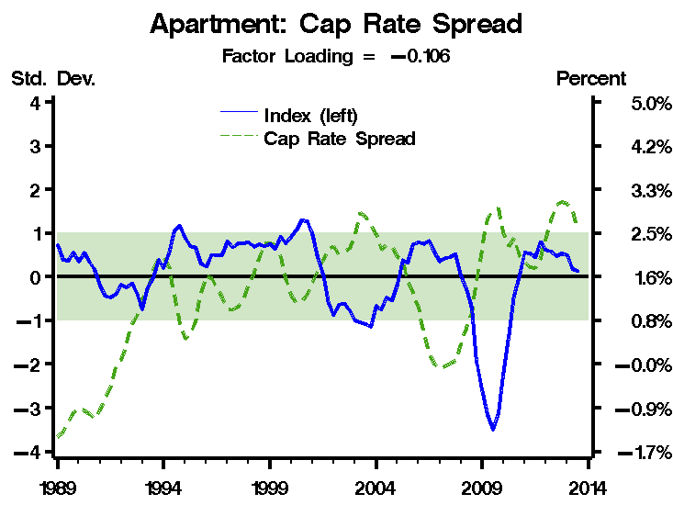
Apartment Market Index – Other Components

Slide 12
Real Estate Cycle Clock - Apartment
12
Overshooting Phase
Decline
Phase
9
3
Growth
Phase
Absorption
Phase
National Apartments - 7:30
6

Slide 13
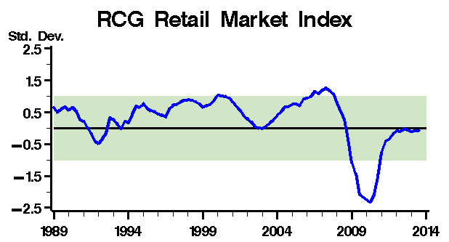
RCG Retail Market Index
The Retail Market Index is in broadly neutral territory, indicating no more than mean market risk.

Slide 14
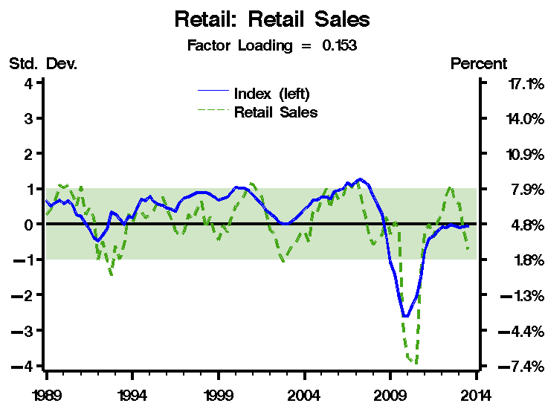
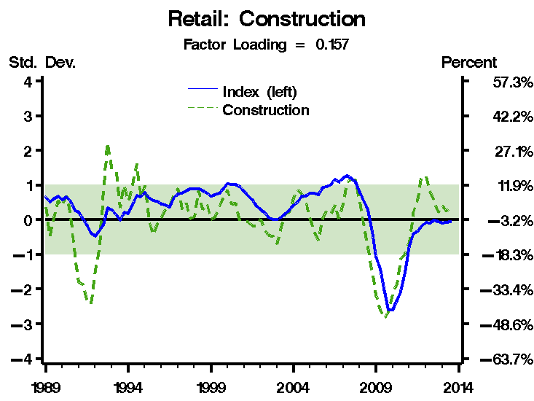
Retail Market Index – Market Forces
Demand Indicator
Supply Indicator
Retail sales growth is about 0.8 standard deviations below its mean of 4.8% growth.
Construction is between 0.2 and 0.3 standard deviations from its mean growth (which happens to be negative 3.2%).

Slide 15
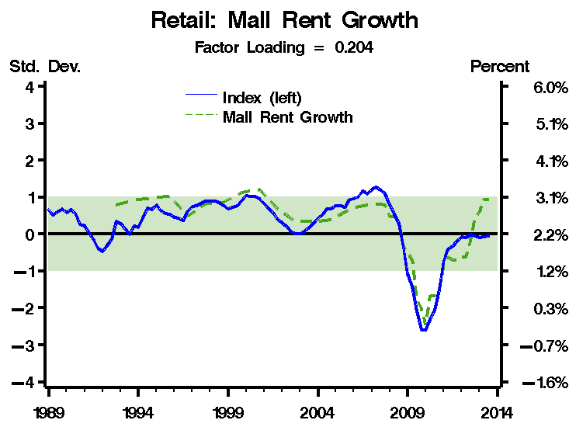

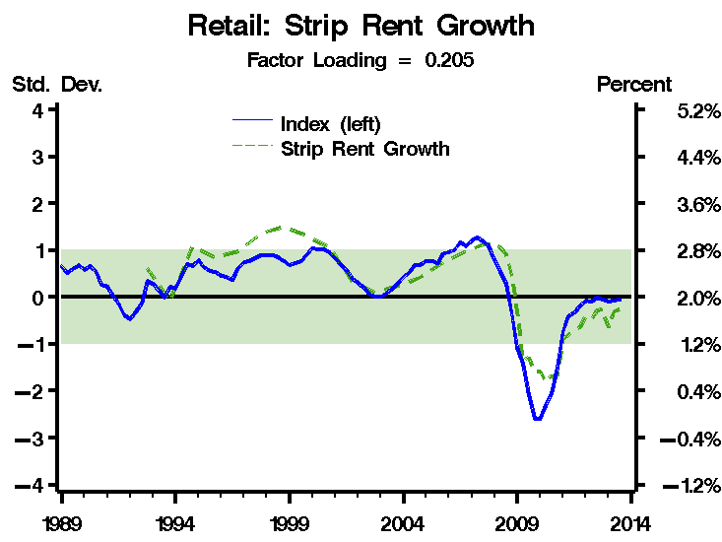
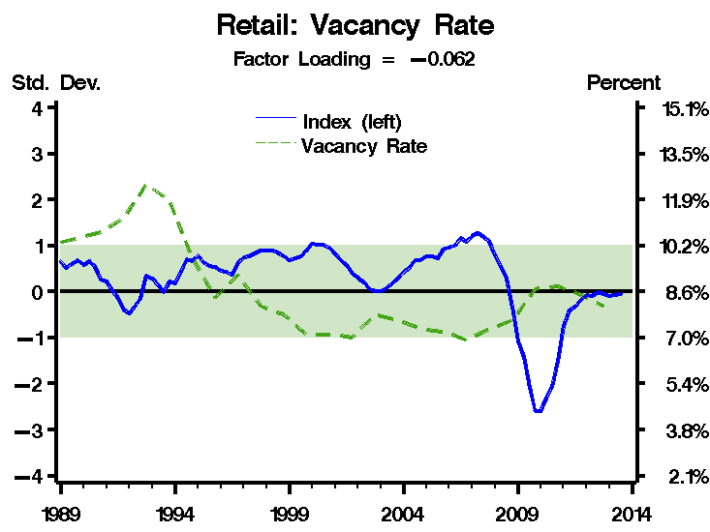
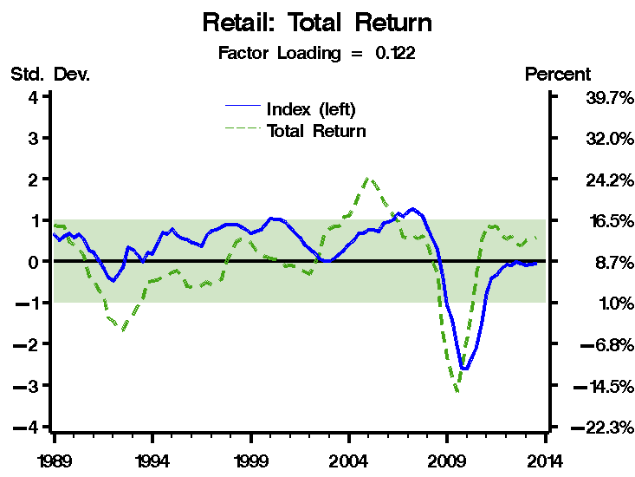
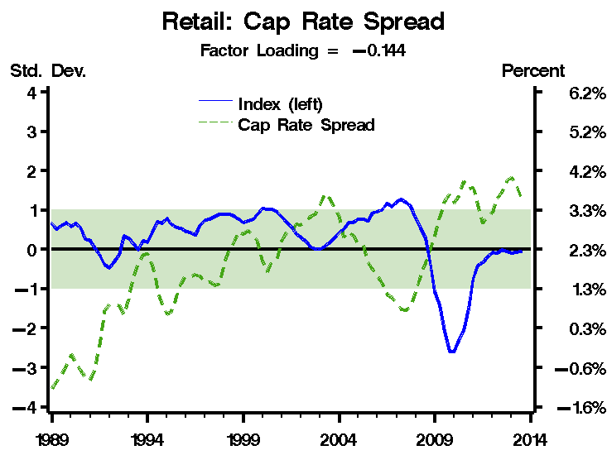
RCG Retail Market Index – Other Components

Slide 16
Real Estate Cycle Clock - Retail
12
Overshooting Phase
Decline
Phase
9
3
National Class C Malls - 3:30
Growth
Phase
Absorption
Phase
National Power Center - 4:00
National Outlet Center - 6:30
6
National Neighborhood Strip - 5:00
National Class A Malls - 6:00

Slide 17
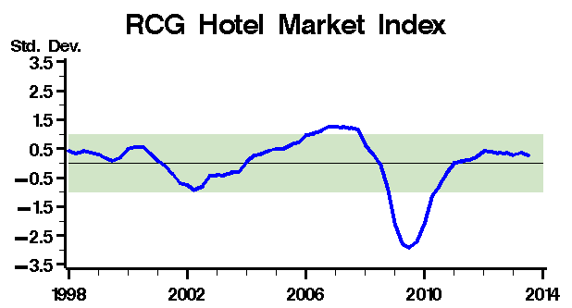
RCG Hotel Market Index
The Hotel Market Index is in slightly positive territory, but is heading down. This implies less than mean market risk at the moment with risks increasing.

Slide 18
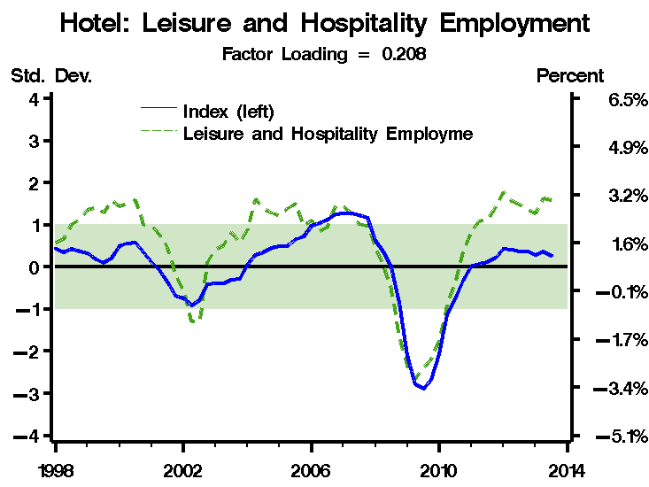
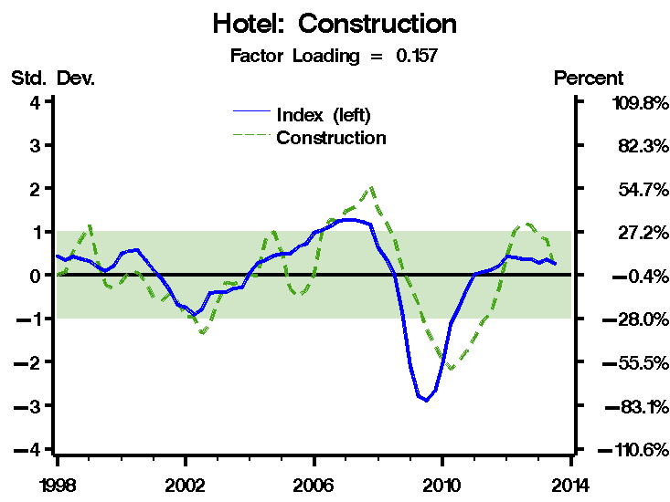
Hotel Market Index – Market Forces
Demand Indicator
Supply Indicator
Leisure and hospitality employment is not a demand factor, but a “derived demand” factor. As such, it allows us to measure demand indirectly. It is about 1.5 standard deviations from its mean growth of 1.6%, indicating strong (derived) demand.
Supply growth is more contained, but is still about 0.3 standard deviations above its mean growth.

Slide 19
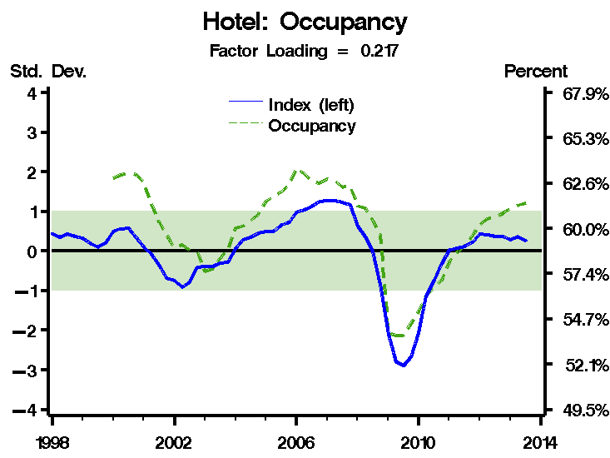
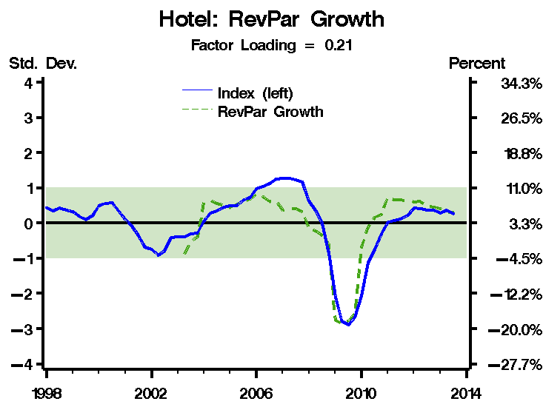
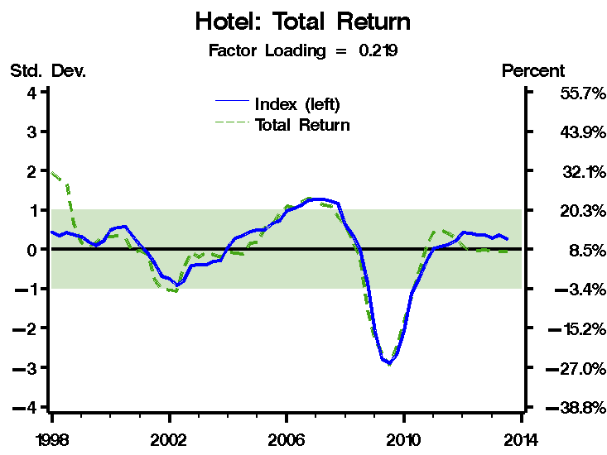
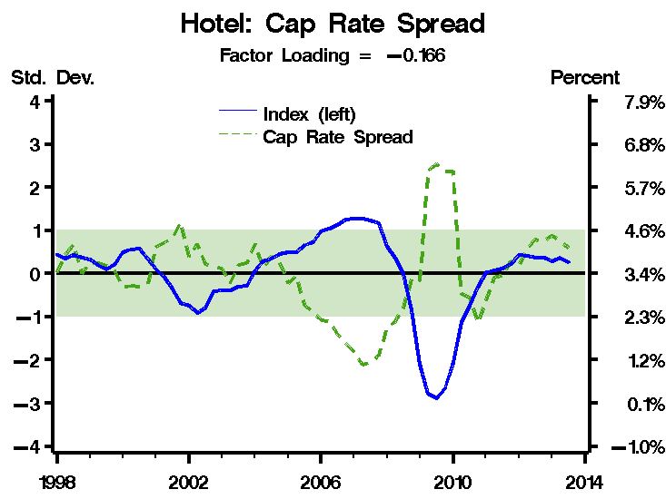
Hotel Market Index – Other Components

Slide 20
Real Estate Cycle Clock - Hotel
12
Overshooting Phase
Decline
Phase
9
3
Growth
Phase
Absorption
Phase
Limited Service Hotels - 7:00
6
Extended Stay - 5:00
Full Service Hotels / Resorts - 6:00

Slide 21
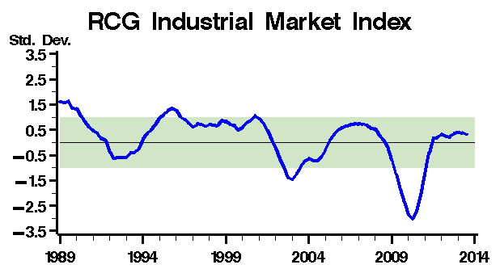
RCG Industrial Market Index
The Industrial Market Index is in unambiguously positive territory, about 0.3 standard deviations from the mean.

Slide 22
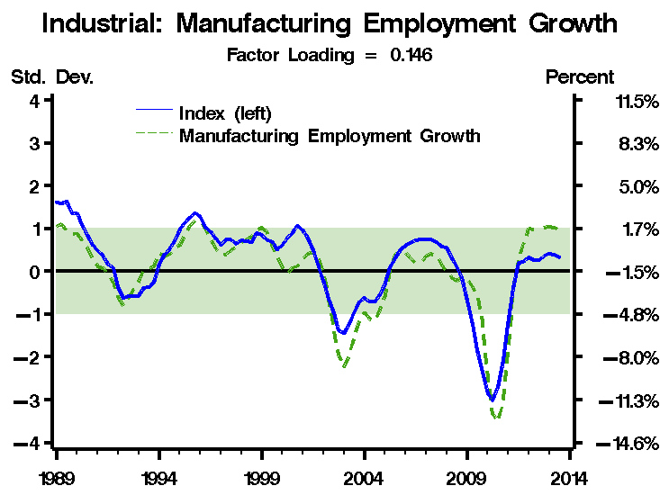
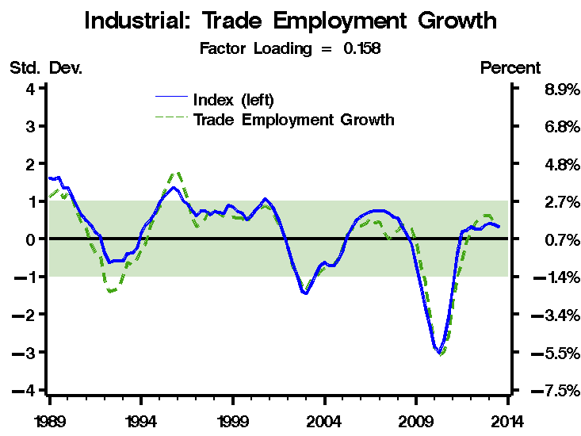
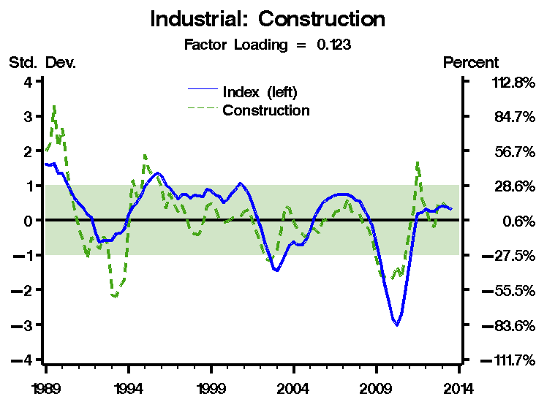
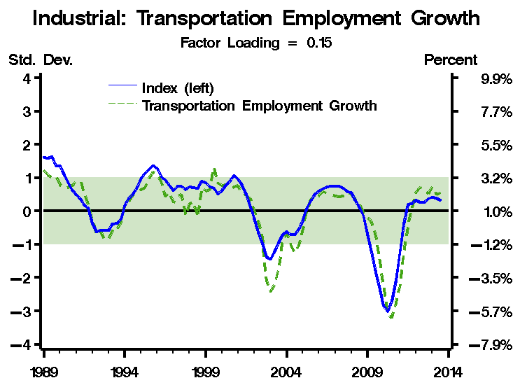
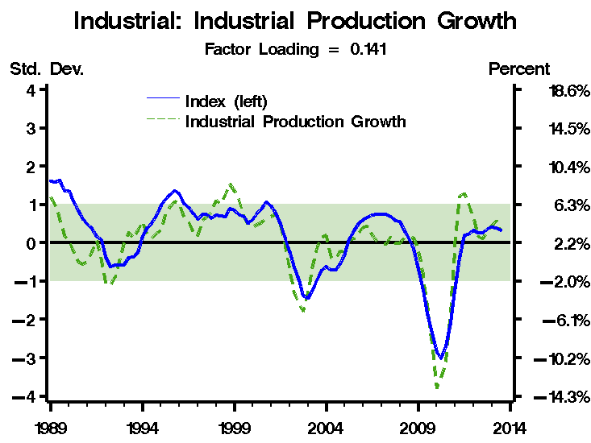
Industrial Market Index – Market Forces
Demand Indicators
Supply Indicator
Demand indicators (again, some are derived demand factors) are all in positive territory with manufacturing and trade employment especially so.
Construction is at its mean of 0.6% year-ago growth.

Slide 23
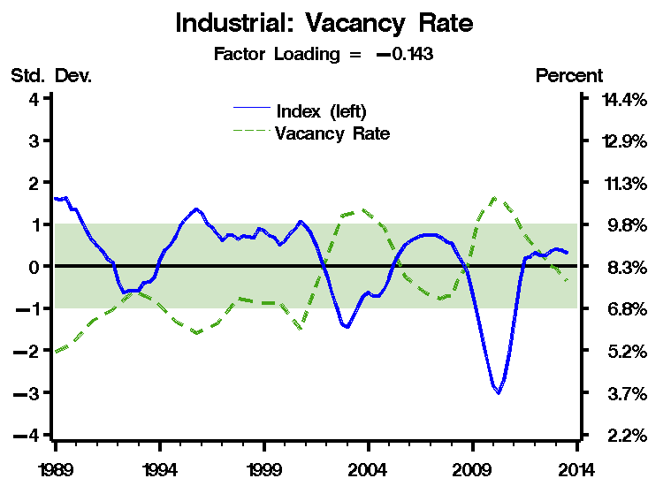
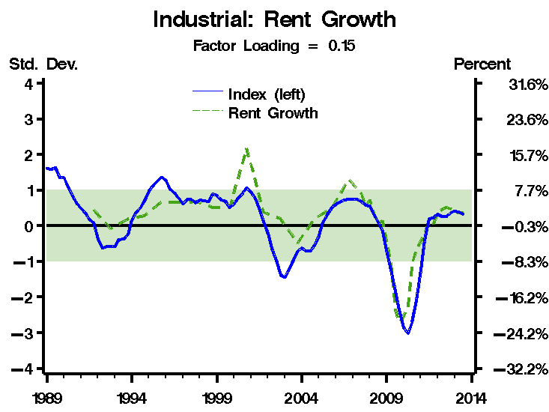
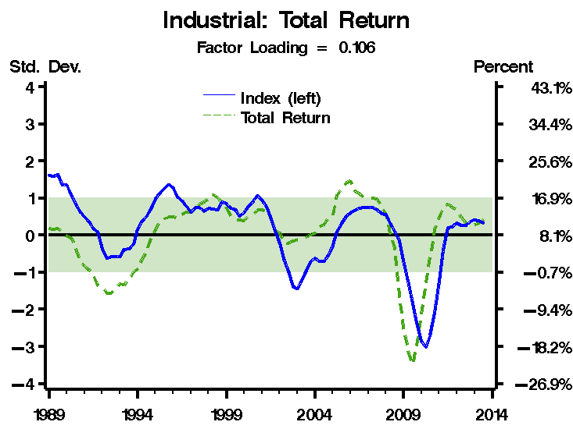
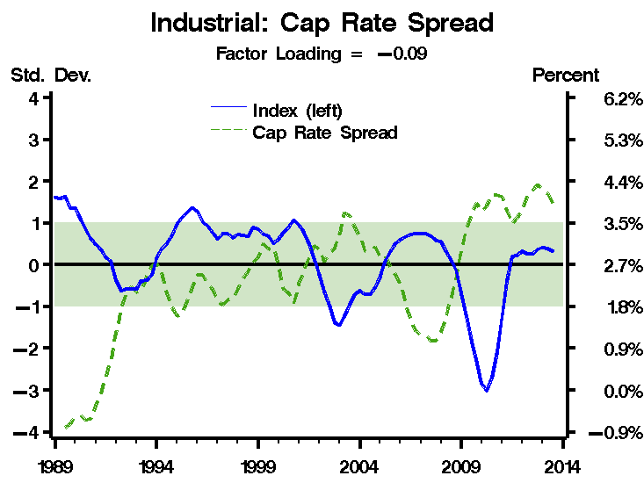
Industrial Market Index - Other Components

Slide 24
Real Estate Cycle Clock - Industrial
12
Overshooting Phase
Decline
Phase
9
3
Growth
Phase
Absorption
Phase
6
National Industrial - 6:00

Slide 25
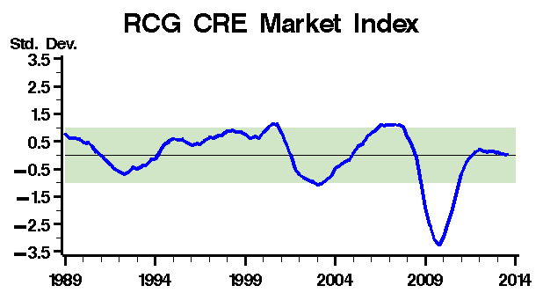
CRE Market Index
We created an overall index out of the five product-type indices. We did this, again, using PCA on the five product-type indices.
This CRE Market Index is the first principal component of the data consisting of the five product-type indices.

Slide 26
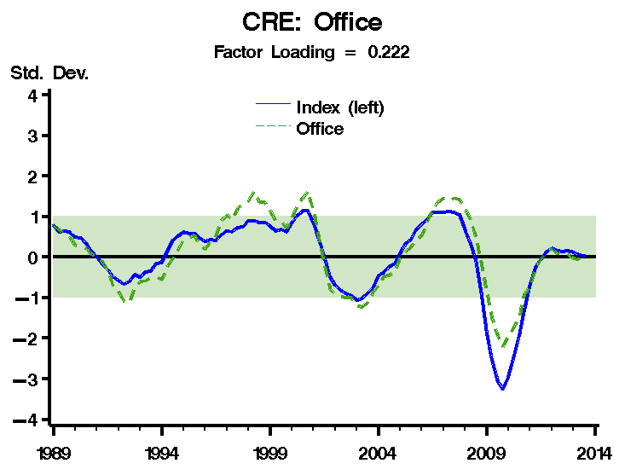
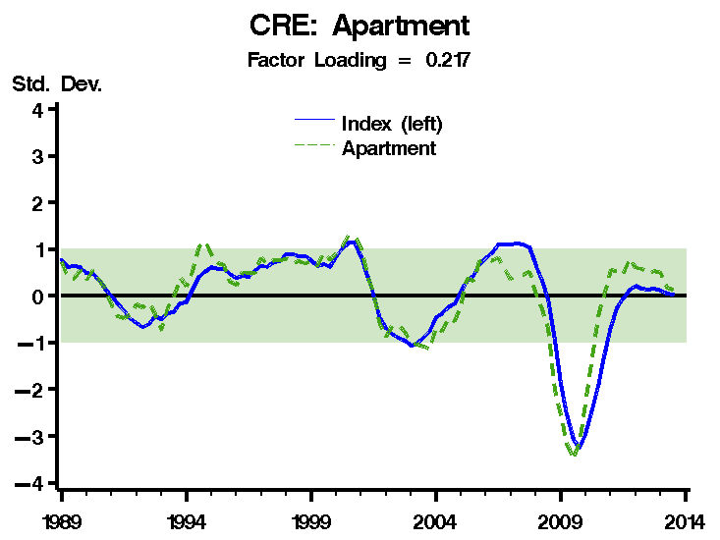
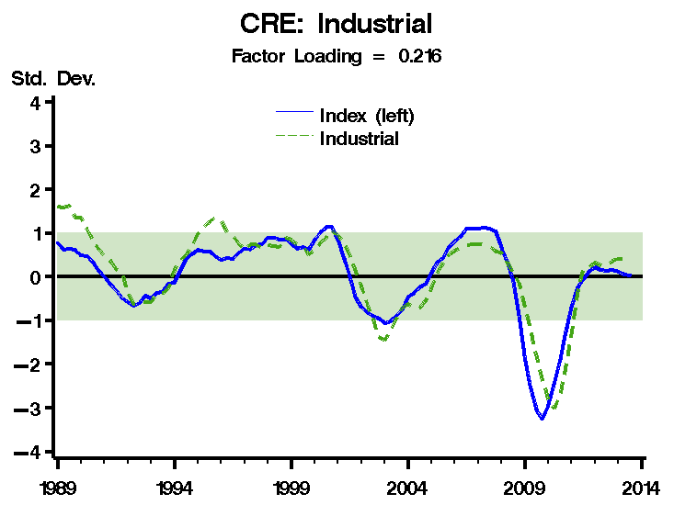
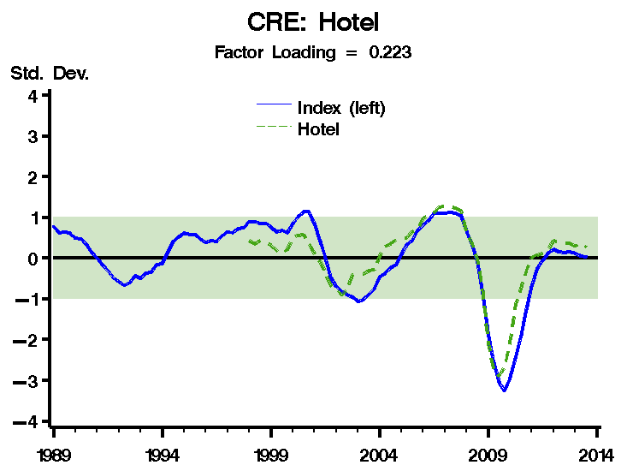
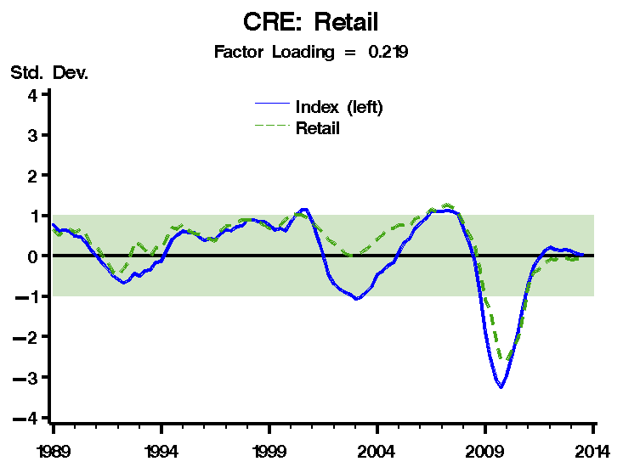
CRE Market Index – Product-Type Components

Slide 27
Extension to MSAs
With the approval of Union Bank, we will replicate the RCG CRE Market Indices for ten MSAs, and each of five product types, data permitting.
The MSA-level data for the hotel product type is constrained at the MSA level.
For rates of return, we will have to use the NCREIF Census Region rates of return for each MSA in the region.
Additionally, some date-range constraints may present themselves as we get into it.

Slide 28
Rosen Consulting
1995 University Avenue
Berkeley, California 94704
510-549-4510
www.rosenconsulting.com

